Slide 1

Photo Story-3
Pankaj Kumar
DAV Ambuja Vidya Niketan Public School, Darlaghat, Solan, HP-171102

Slide 2
Photo Story (A new Dimension)
Photo Story 3 is a fantastic, free program that is used widely in Early Phase classrooms to Senior Level and beyond.
It is great to use because it is easy to learn and because it has a ‘wizard’ style set up which means it takes you step-by-step through the tasks you need to complete to create your story.
Photo Story is so easy to use that within minutes of being introduced to Photo Story, most Early Phase students and teachers are creating their first Photo Story masterpiece!

Slide 3
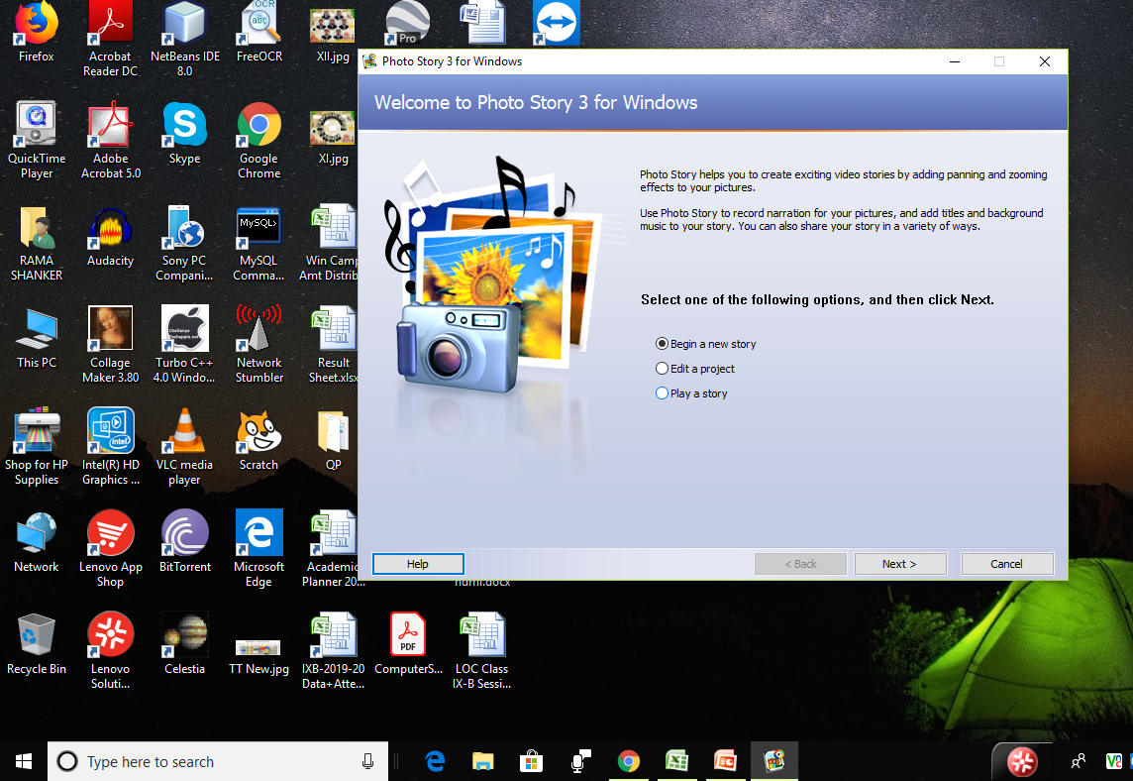
Have Photostory-3 in your Computer
Microsoft Photo Story 3 Download Page http://www.microsoft.com/photostory
Getting Started:
Select Begin a New Story. Click the Next button to move on to the next step.
Prerequisites:
Original OS
Licensed Copy
2GB RAM with 50 MB Space
Get from Microsoft Site only
Install with Normal and easy Steps.

Slide 4
Let us Begin the Story of Microsoft Photo Story-3

Slide 5
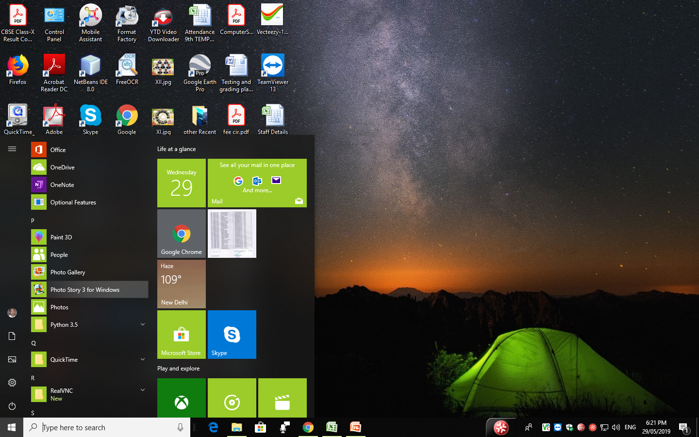
Click here to Start Photo Story-3

Slide 6
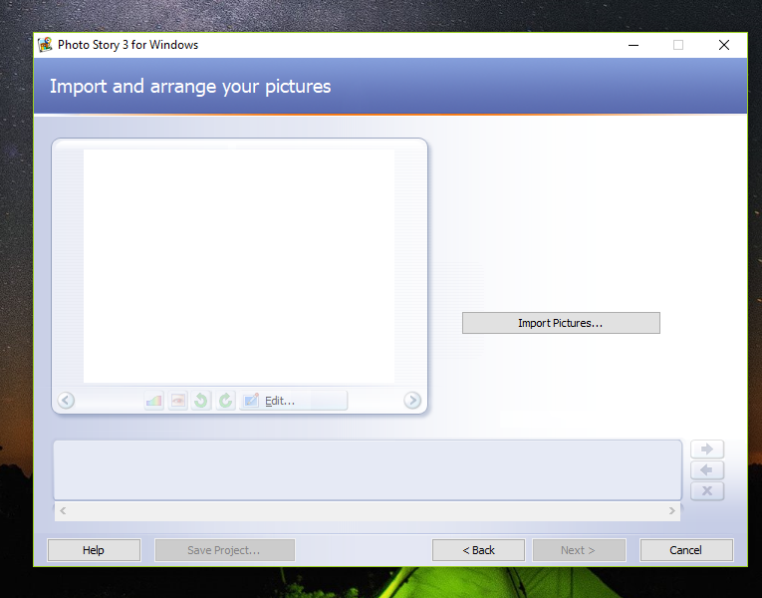
In this step, click on the Import Pictures button and locate the images on your computer that you wish to use as part of your Photo Story. Note that you can import more than one photo at a time. To do this, hold down the Ctrl key on your keyboard and click on the images you wish to import. Press OK.

Slide 7
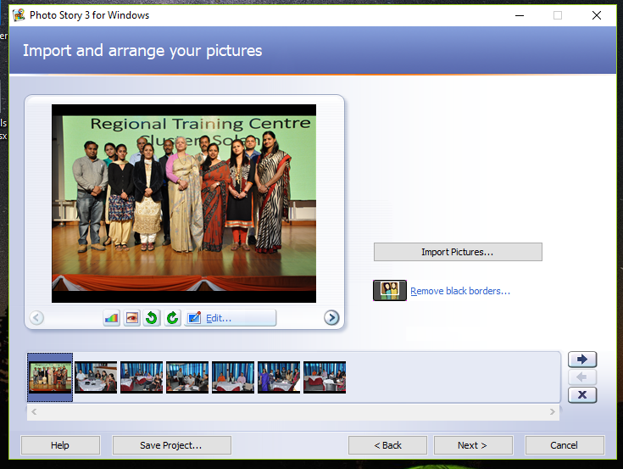
Reorder your images by clicking and dragging them into different places or by selecting an image and using the arrows to move them forward or backwards. • delete your images by clicking on the image and pressing the X button. .

Slide 8
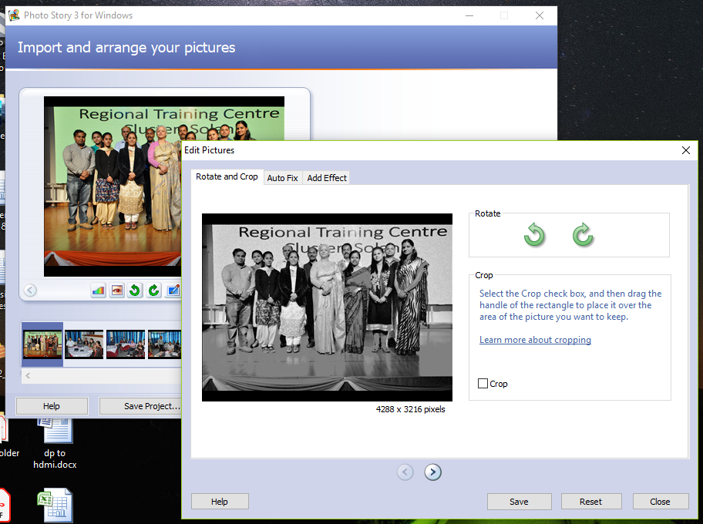
As part of this step in the Photo Story wizard, you can enhance or edit your photographs.
Correct Colour Levels by selecting this button.
Remove Red Eye by selecting this button.
Rotate the photo by clicking on these buttons.
Edit the photo by cropping it, fixing the colour or adding effects.

Slide 9
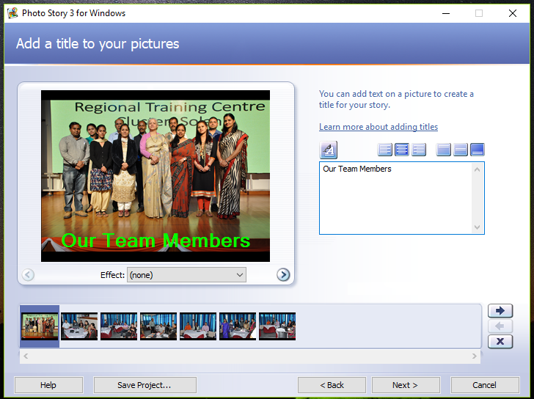
Adding text:
Select the photo you wish to add text to.
Enter the text in the text box provided.
Use the A button to choose the font, type and colour for your text.
Select save and repeat this process for each photo.

Slide 10
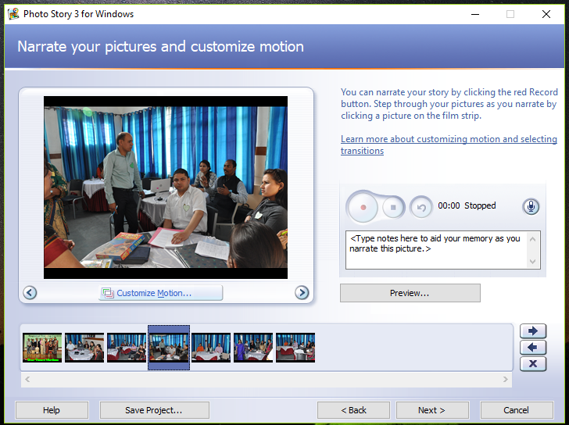
Record your narration:
Plug in your microphone.
Select the red circle button to begin recording
Press the preview button to see what your story looks like with the narration.

Slide 11
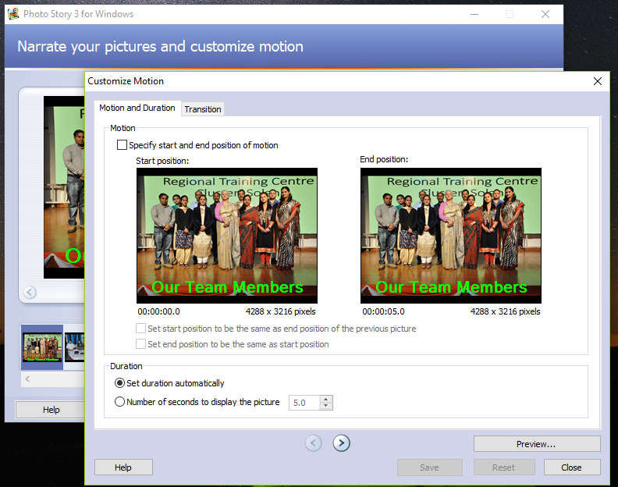
Customising Motion: Add interest to your photo story through the use of motion and transitions.
Select an area of your photo that you want to use as a start position and End position. It has a large collection of transitions.
The screenshot to the right shows the preview of the Circle Outwards transition being applied to the pink and yellow photos.

Slide 12
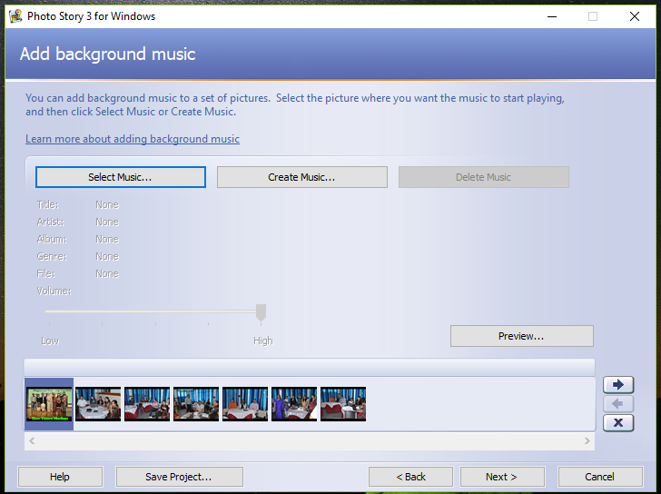
Add Background Music
Select the photo where you want the music to start playing.
If you have an existing music file (in wav, mp3 or wma) use it.
OR select Create Music to select inbuilt Music.
Select OK and then Preview to view your story with the music.

Slide 13
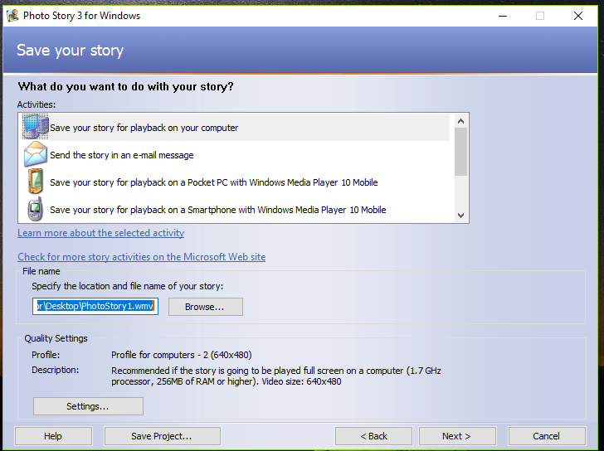
Save and Publish your Photo Story:
It is now time to save your final photo story. When we save our photo story, we save it as two different files.
The first is the Project file that you can open in Photo Story.
The second file is the one that we can share with others. This is usually a WMV (Windows Media Video) format.

Slide 14
Now, Create your own Story!

